Slide 1
FP6 DISSAMINATION & EXPLOITATION
Prof. dr Slaviša Trajković
University of Niš
Kick-off meeting/21 December 2018
This project has been funded with support from the European Commission. This publication reflects the views only of the author, and the Commission cannot be held responsible for any use which may be made of the information contained therein.

Slide 2
Dissemination and Exploitation Issues
Project dissemination will involve institutional, national and international level of activities. It will be focused on promotion the project itself, its objectives and achieved results and participants and to raise awareness of the general public about the potential benefits of the project results.
Exploitation will be achieved through the accreditation of new developed master curricula and organisation of next activities:
Info days for student enrolment
Trainings for professionals in water sector
Winter/summer schools
Symposium for promoting WRM in WBs
Strengthening of master curricula in water resources management
for the Western Balkans HEIs and stakeholders
www.swarm.ni.ac.rs

Slide 3
WP6 Activities
The WP6 is subdivided into six activities:
* A6.1 Creation of the Dissemination & Exploitation Plan
* A6.2 Development of project website and promotional materials
* A6.3 Info days for student enrolment
* A6.4 Roundtables with non-academic sector
* A6.5 Winter/summer schools
* A6.6 Symposium for promoting WRM in WBs
Strengthening of master curricula in water resources management
for the Western Balkans HEIs and stakeholders
www.swarm.ni.ac.rs

Slide 4
A6.1 Creation of the Dissemination & Exploitation Plan
Dissemination and Exploitation plan will be created at the beginning of the project, adopted at the first Steering Committee meeting and will include the following key elements: purpose, target groups, messages, methods and timing.
The activity will be organized during the first project year
Outcome: D&E Plan created
Due date: 14-04-2019
Strengthening of master curricula in water resources management
for the Western Balkans HEIs and stakeholders
www.swarm.ni.ac.rs

Slide 5
A6.2 Development of project website and promotional materials
The project website was created and will be regularly maintained and updated. Information will be presented in all partners’ languages.
Promotional material (bag, leaflet, project brochure, pencil, folder, poster, roll-up) including visual identity was designed and printed. Dissemination strategy will be developed and dissemination activities and tools planned.
The activity will be organized through entire project
Outcome: Promotion material created
Due date: 14-11-2021
Strengthening of master curricula in water resources management
for the Western Balkans HEIs and stakeholders
www.swarm.ni.ac.rs

Slide 6
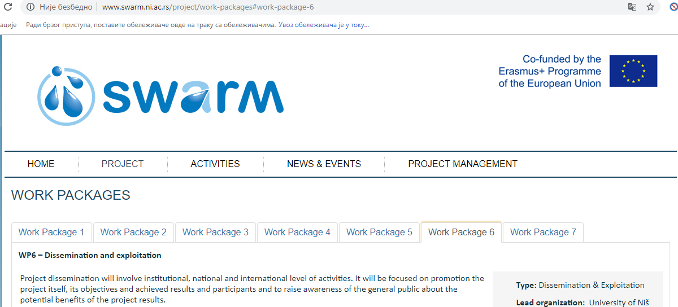
A6.2 Project website
Strengthening of master curricula in water resources management
for the Western Balkans HEIs and stakeholders
www.swarm.ni.ac.rs

Slide 7
A6.2 Promotional materials
Roll-Up
Brochure
ID card
Strengthening of master curricula in water resources management
for the Western Balkans HEIs and stakeholders
www.swarm.ni.ac.rs

Slide 8
A6.3 Info days for student enrolment
Seven info days for promotion enrolment of master students will be performed in the WB HEIs (covering consortium partners and the other related HEIs). The promotional materials for student enrolment will be delivered to inform future students about newly developed curricula.
Second project year
Outcome: Info days organized
Due date: 14-10-2020
Strengthening of master curricula in water resources management
for the Western Balkans HEIs and stakeholders
www.swarm.ni.ac.rs

Slide 9
A6.4 Roundtables with non-academic sector
Seven roundtables with participation of non-academic sector will be organised for the promotions of trainings for professionals in water sector by WB HEIs staff. The promotional materials regarding SWARM project and trainings will be delivered to all interested parties. PWMCVV and associated partners from water sector will take participation and help WB HEIs in organisational activities.
Activity from second project year
Outcome: Roundtables organized
Due date: 14-11-2020
Strengthening of master curricula in water resources management
for the Western Balkans HEIs and stakeholders
www.swarm.ni.ac.rs

Slide 10
A6.5 Winter/summer schools
The students’ short-time mobility from WB to EU partner HEIs is planned. Three winter (January 2021 – UL and AUTH, February 2021 – UNIRIFCE) and three summer schools (June 2021 – NMBU and BOKU, July 2021 – UACEG) in duration of 5 days will be organized with a participation of 13 WB students per school.
The activity will be organized during the third project year.
Outcome: Winter/summer schools organized
Due date: 14-09-2021
Strengthening of master curricula in water resources management
for the Western Balkans HEIs and stakeholders
www.swarm.ni.ac.rs

Slide 11
A6.6 Symposium for promoting WRM in WB
Symposium for promoting water resources management in WBs will be organized in the third project year by UNS in July 2021. Participants from the partner institutions (24 teaching staff) will prepare and present their research.
Activity from third project year
Outcome: Report on organized Symposium
Due date: 14-08-2021
Strengthening of master curricula in water resources management
for the Western Balkans HEIs and stakeholders
www.swarm.ni.ac.rs

Slide 12
WP 6 - Workplan
Strengthening of master curricula in water resources management
for the Western Balkans HEIs and stakeholders
www.swarm.ni.ac.rs

Slide 13
Thank you.
Strengthening of master curricula in water resources management
for the Western Balkans HEIs and stakeholders
www.swarm.ni.ac.rs

